Slide 1


Artificial Intelligence Technology Centre

Slide 2
Wan2.2 Video Generator
Presented by:
Ali Haider
Int-1846
Supervisor:
Mr Awais Akhtar
CoE AITeC
Director:
Dr. Khursheed Hasnain
Dated: 29-10-2025

Slide 3

Introduction
Wan2.2 is a state-of-the-art AI model designed for text-to-video generation, capable of producing high-quality, visually consistent clips.
It enables creators and developers to generate video content directly from textual prompts without requiring manual animation or filming.
With the increasing demand for automated video generation in marketing, entertainment, and creative industries, AI models like Wan2.2 are transforming how visual content is produced.
This project leverages Wan2.2 to generate modular 5-second video clips, which are then looped and merged to create longer, continuous videos.
The goal is to explore how AI can automate video creation while maintaining coherence and smooth transitions.

Slide 4
Problem Statement
Traditional video production requires significant time, expertise, and resources, making it inaccessible for rapid content creation.
AI-generated videos are often limited to short durations, reducing their usefulness for longer content formats.
Manual merging of clips can lead to visual discontinuity, frame jumps, or style inconsistencies.
There is a need for an automated system that can generate multiple short video segments and seamlessly combine them into a longer, continuous video.
This project addresses the challenge of scalability and smooth looping in AI-driven video generation.

Slide 5

Project Objectives
Automate video generation using the Wan2.2 AI model based on user-defined text prompts.
Generate multiple 5-second video clips in a looped sequence to extend total video duration.
Ensure smooth transitions between clips by maintaining consistent visual style and motion.
Merge AI-generated segments into a final continuous video automatically.
Demonstrate how AI can enhance scalability, efficiency, and creativity in video production.

Slide 6
Technology & Tools
Core AI Model
Wan2.2 – Advanced text-to-video generation model
Frameworks & Libraries
PyTorch (torch, torchvision, torchaudio) –
Diffusers & xFormers
Accelerate & Triton – High-performance computation
Einops, TorchSDE – Neural network operations and stochastic differential equations
Custom Nodes & Extensions (ComfyUI)
ComfyUI_GGUF, KJNodes – Specialized nodes for Wan2.2
Model loaders (LoRA, VAEs, CLIP) – For text encoding and style control
Video & Image Processing
OpenCV, albumentations, imageio – Frame processing
FFmpeg, WEBM, WEBP – Video rendering and saving
Practical-RIFE – Frame interpolation for smoother motion
Development Environment
Google Colab – Cloud GPU execution
Aria2c & wget – High-speed model downloading automation

Slide 7
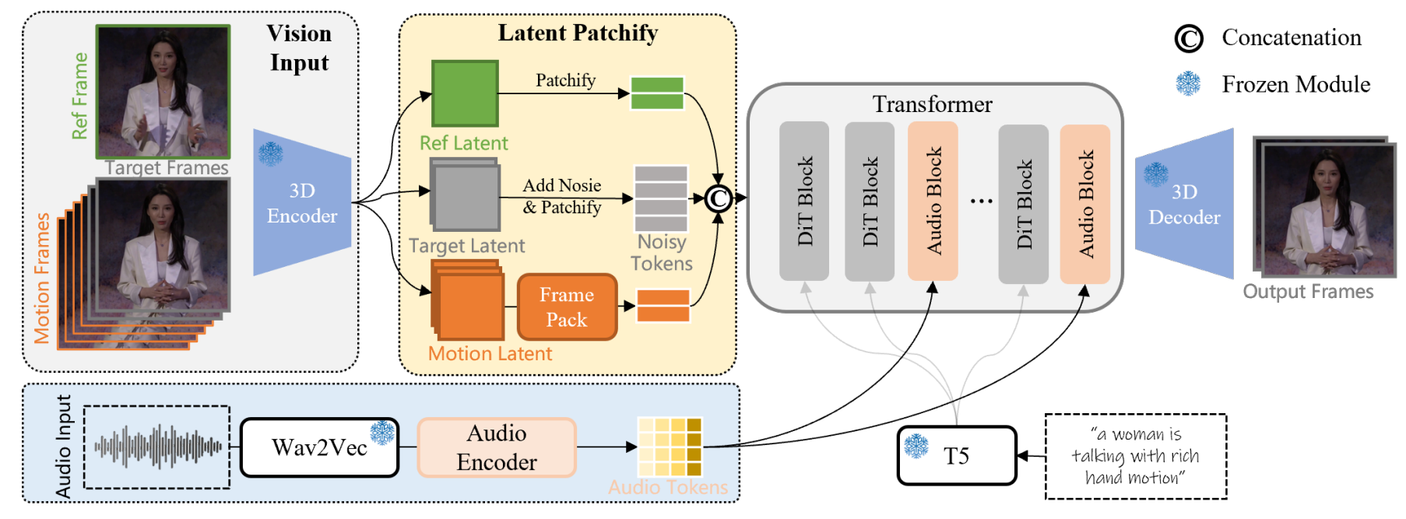
WAN2.2 TI2V

Slide 8
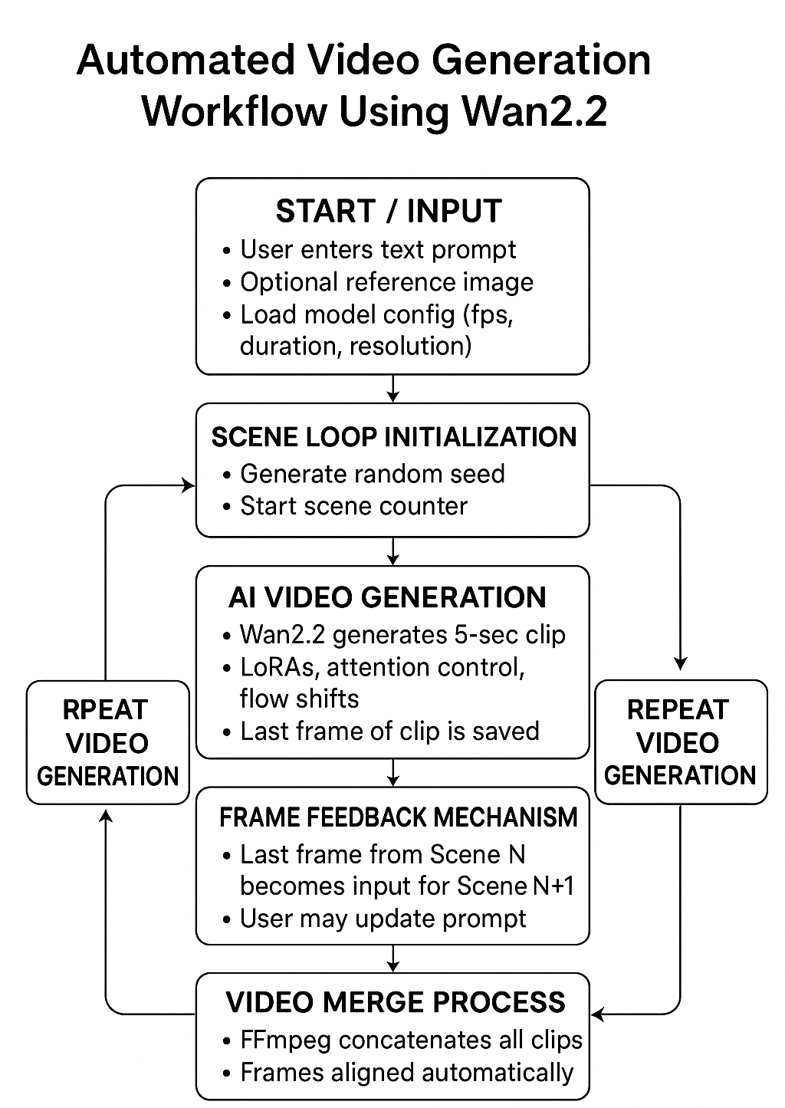

Slide 9
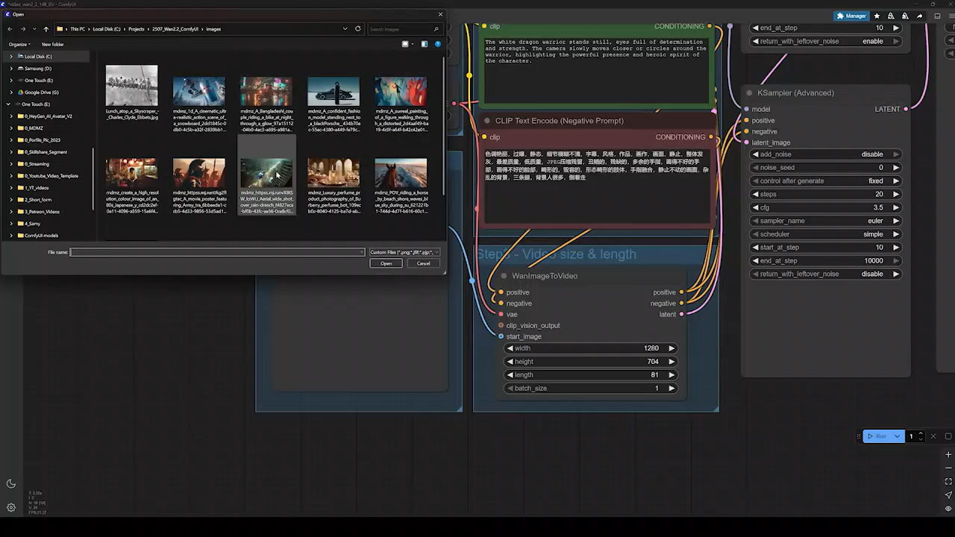
COMFY UI OVERVIEW

Slide 10
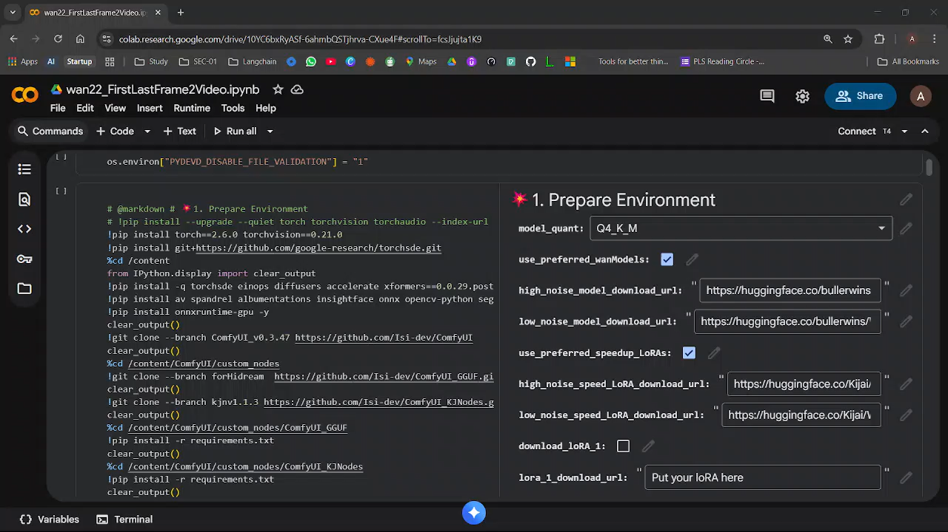
CODE OVERVIEW

Slide 11
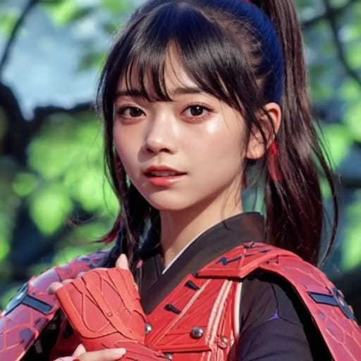

SCENE 1
INPUT 1
GENERATED VIDEO 1

Slide 12
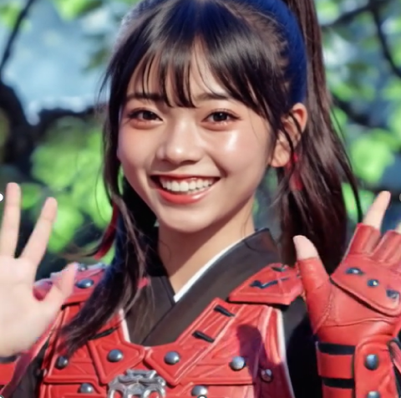
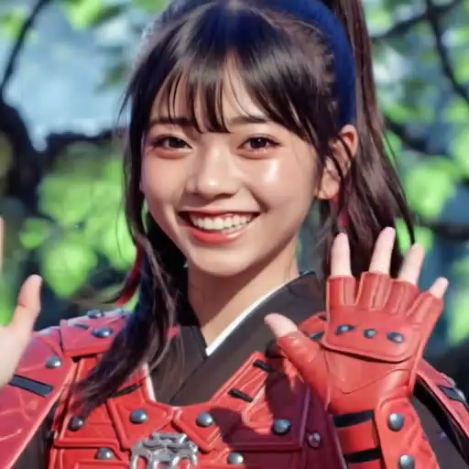
SCENE 2
INPUT 2
GENERATED VIDEO 2

Slide 13
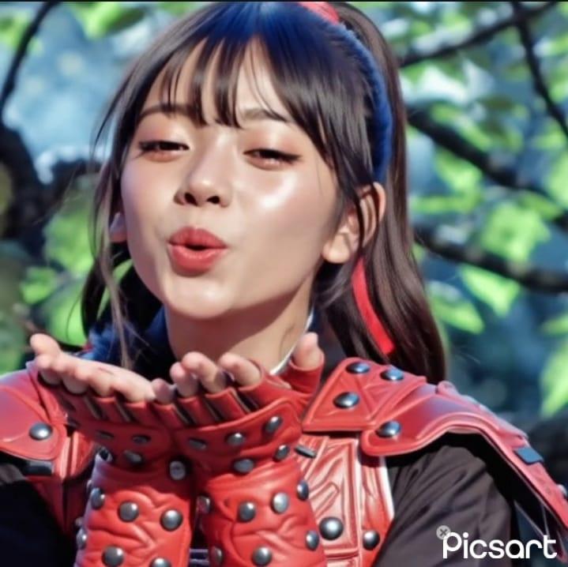
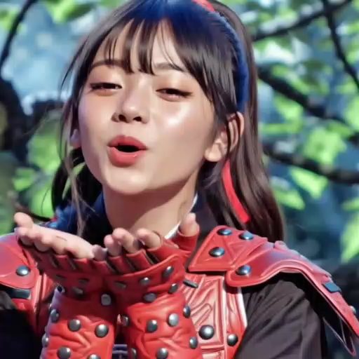
SCENE 3
INPUT 3
GENERATED VIDEO 3

Slide 14
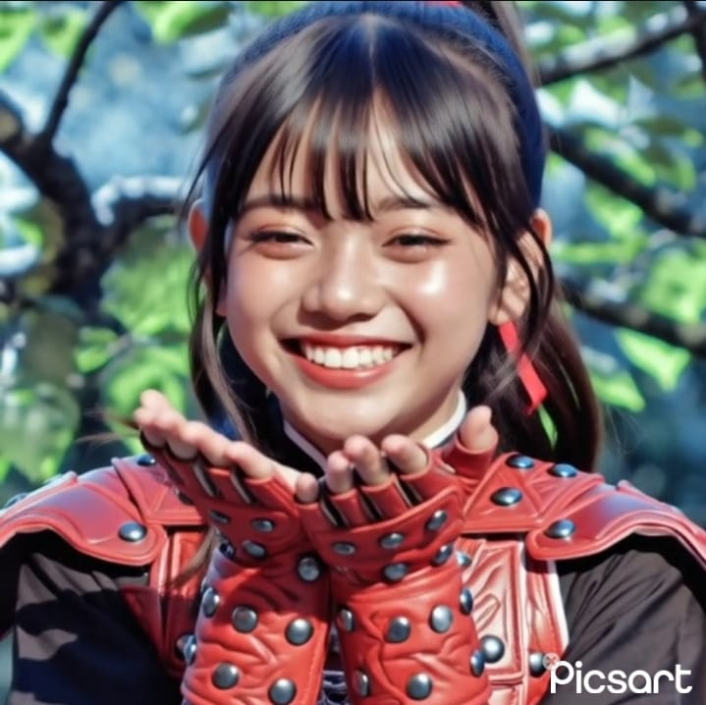
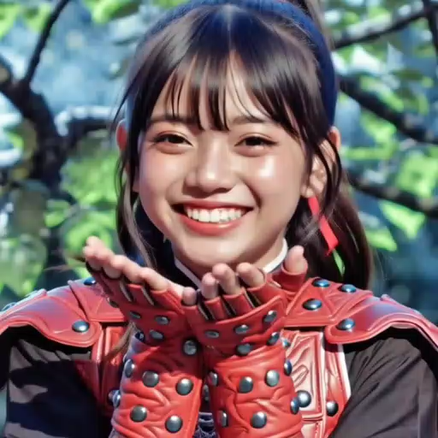
SCENE 4
INPUT 4
GENERATED VIDEO 4

Slide 15
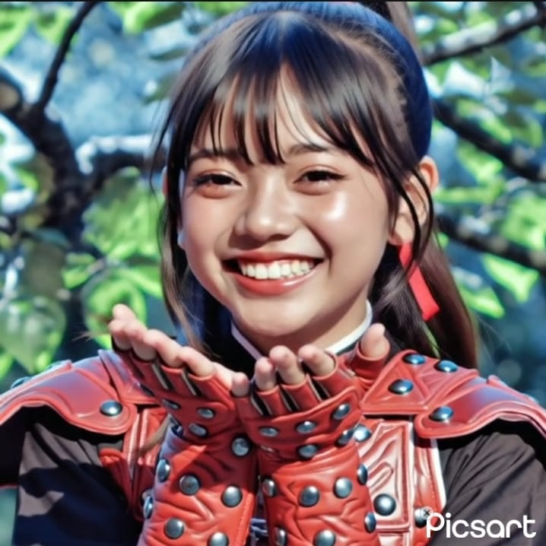
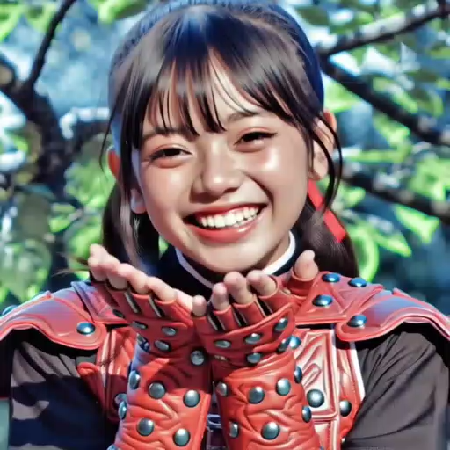
SCENE 5
INPUT 5
GENERATED VIDEO 5

Slide 16
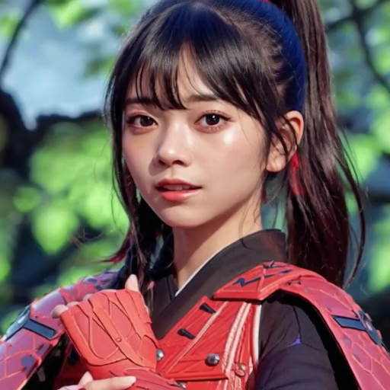
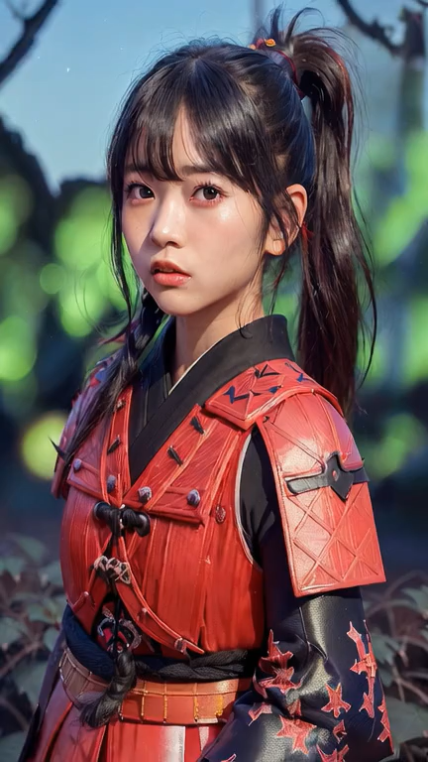
Results

Slide 17
Future Work
AI Prompt Evolution
Enable autonomous prompt refinement using AI agents
Context-aware storytelling across scenes
Advanced Editing & Effects
Add audio generation and synchronization
Integration of camera movement control nodes
Evaluation Metrics (Future Implementation)
Visual Quality Evaluation: assess clarity, consistency, and realism of generated scenes
Continuity Scoring: measure coherence between consecutive scenes (character stability, lighting)

Slide 18
Thank You
ANY QUESTIONS?

